Slide 1

Softwaring in Clojure
Yoav Rubin

Slide 2
About me
Software engineer in IBM Research, Haifa
  Worked on
    From large scale products to small scale research projects
  Domains
    Software tools
    Development environments
    Simplified programming
  Technologies
    web (single page applications)
    Java, Clojure
Lectured the course “Functional programming on the JVM” in Haifa University
{:name “Yoav Rubin,
:email yoavrubin@gmail.com,
:blog http://yoavrubin.blogspot.com,
:twitter @yoavrubin}

Slide 3
Roadmap
Clojure
Softwaring
In

Slide 4
Clojure

Slide 5
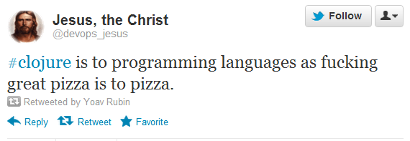

Slide 6
It’s a Lisp
S-expressions ^{[1]}
Operator / Function names
(+ 2 4) ;6
Arguments

Slide 7
It’s a Lisp
S-expressions
Higher order functions
Evaluating the first term and returning a function
(
(if (< 1 3)
+ ; if true
- ; if false
) 2 4) ;6

Slide 8
It’s a Lisp
  Homoiconicity
    code is data
  Macros
    Reader macros were added
      Is it an improvement ?

Slide 9
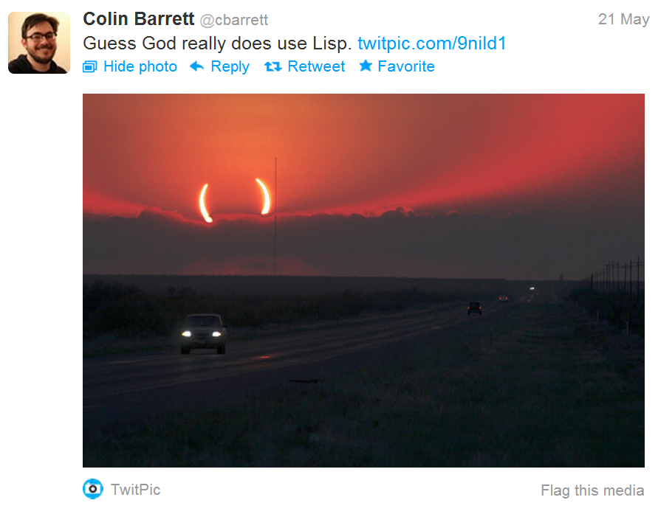
It’s a Lisp
Need to get used to parentheses

Slide 10
Basic types
Semantics | example | syntax
Boolean | true , false | true, false
Character | \a , \u2235 | Starts with \ or \u for unicode
String | “abc” | Surrounded with “”
keyword | :kw | Colon
No value | nil | Nil

Slide 11
Basic types – numbers (all boxed)
Semantics | example | syntax
Integer | 1 , 2 | Digits
Big integer | 34N | Digits, doesn’t matter how much, N
double | 1.7e8 | Digit, decimal point, digits, possible exp
Big decimal | 0.3M | Digit, decimal point, digits, possible exp, M
Ratio | 13/4 | Two integers with / between them

Slide 12
Data structures
There are several built in data structures
All are immutable and persistent ^{[2]}
Can hold different types of items
Nestable
Name | example | syntax
List | (“a” 1 :b) | braces
Vector | [“a” 1 :b] | brackets
Map | {:a “a”, 1 :1} | Curly braces
Set | #{“a” 1 :b} | Hash then curly braces

Slide 13
Vector - semantics
An indexed sequence of items
  Allows accessing to items by index
  Near constant time for read, add*, sub-vec
* Nothing is really added

Slide 14
Map - semantics
A sequence of key-value pairs
  Allows accessing elements by their key
Near constant time for read, add*, remove*
* Nothing is really changed

Slide 15
List – semantics
List of items, constant time for add*, linear time for read
Execution
  Function call, macro, special form
    First item is the operator (e.g., a function)
    Rest of the items are the arguments
* Nothing is really added

Slide 16
Types
Dynamic typing
Type hints
  Can boost up performance
Define your own
  Records
  Types

Slide 17
Baked in concurrency
Referenced type with mutability semantics
  Var - Isolated change within a thread
  Atom - Shared, synchronous, autonomous
  Ref - Shared, synchronous, coordinated
  Agent - Shared, asynchronous, autonomous
Concurrency interaction schemes
  Future – “get back to me when you’re done”
  Promise – “I’ll tell you when I’m done”

Slide 18
Hosted, symbiotic, language
On the JVM
On the CLR
ClojureScript – compile Clojure to JavaScript

Slide 19
Tons of great ideas (random order)
Seq abstraction
Metadata
Polymorphism and dispatching
Destructuring
Zippers
Laziness
Transients
STM
…

Slide 20
Softwaring

Slide 21
“…Clojure is not so much of a programming language, it's a vision for how to build software that you can only realize by building a programming language…”
Neal Ford

Slide 22
Softwaring
Programming => developing program
Softwaring => developing software

Slide 23
Softwaring
All the things we do to produce a software
  Beyond just programming
All the things that enable us to go from making programs (even large ones) to making software

Slide 24
Softwaring
Programming is to softwaring as chemistry is to biology
  Biology is not just a lot of chemistry

Slide 25
Softwaring
How would you define the difference between program and a software
It is more about the internal structure then the way it is externally perceived
  From a single component that does everything to a set of specialized components that work together

Slide 26
In

Slide 27
Softwaring in Clojure
Namespaces
  Manage the internal complexity of a component
  Define the dependencies between components
Interop with the hosting environment
  Using APIs of other components
  Providing APIs for other components to work with
  Adhering to the project’s error handling mechanisms
Testing
  Adhering to the culture of modern software development

Slide 28
Namespacing
A space that holds names (symbols) together
  To create a semantically distinct area
  A software organ
    Think of a a java package
Defining the dependencies between this and other components

Slide 29
(ns my-namespace
(:<directive> ; use/require/import
(<pathFromRoot>?
[remainingPath :whatToDo [nodeToLeaf | name] ]⁺
|| remainingPath⁺
)⁺
)*
)

Slide 30
Interoperability – API usage
Class Instantiation
Method invocation (incl. static methods)
Fields access (r/w) (incl. static fields)
Extending classes / abstract classes
Interface implementation

Slide 31
Interoperability – API definition
Class generation
Interface generation

Slide 32
Clashing of programming models
Clojure prefers laziness and referential transparency
Java does not have laziness, and OO coding relies on side-effects
Clojure provides mechanisms to take care of it

Slide 33
(in a human world metaphor)
We need to overcome the language difference and the cultural difference

Slide 34
Interoperability – error handling
Based on Java’s exceptions model
  (try, catch, finally, throw)
Compile and runtime

Slide 35
Testing
Expectations from a testing framework
  Simple to write tests
  Grouping of tests
  Separation of tests components
  Running specific test
  Reporting the results of the tests
This is what the clojure.test namespace provides

Slide 36
Example – binary search ^{[3]}
First published – 1946
First working version – 1958
The (currently?) last bug found was in 2006

Slide 37
Design by Contract
Defining contracts on functions
More of a programming capability
A building block for libraries that allow defining contracts in a separate way from functions

Slide 38
References
[1] - http://www-formal.stanford.edu/jmc/recursive.pdf
  the original Lisp paper, you won’t regret reading it
[2] - http://www.infoq.com/presentations/Value-Identity-State-Rich-Hickey
  If you plan on seeing just one talk of Rich Hickey, see this one, it will make you change your mind
[4] – Based on the “Beautiful Tests” chapter from the book “Beautiful Code”
[3] - http://2.bp.blogspot.com/-0McXtCCKO48/T3iYGCTh99I/AAAAAAAAHIc/N2Gcjifias8/s1600/keep-calm-and-use-clojure.png

Slide 39

[4]

